Slide 1
Data Storage

Slide 2

Database Management System (DBMS)
Web
Forms
Embedded
SQL
Interactive
SQL
Applications
SQL Commands
DBMS
Query
Evaluation Engine
Concurrency
Control
Files and Access Methods
Recovery
Manager
Buffer Manager
Disk Space Manager
Database
Data
Indexes
Catalog
Notes:
Trace a transaction…

Slide 3
Data Storage
Two DBMS fundamental questions?
How do we store and manage very large volumes of data?
What representation and data structures best support efficient manipulation of data?
RAM model vs. I/O model of Computation
Notes:
I/O model attempts to minimize disk accesses although the algorithm on data in main memory is not what might be consider the best use of main memory.

Slide 4
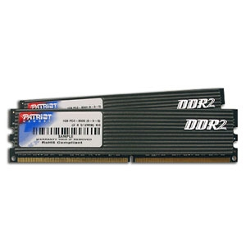
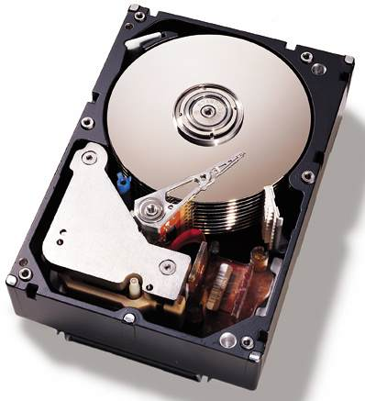
Storage Hierarchy
Speed; $$
Primary Storage: random access; volatile
Cache - on board or level-2 cache
Main memory
Secondary storage: random access; non-volatile
Flash-based or Solid State Disk
Magnetic disk
Virtual Memory (Main-memory DBS), File System, DBMS
Tertiary storage: non-volatile
Optical disk / juke boxes – random access
Magnetic cartridge / tape silos – seq. access
Notes:
Cache in Kbytes; less than 10 nanoseconds
Main Memory in 100MB to 10 gigabytes; 10-100 nanoseconds
Magnetic disks: floppy 1.4 M, Zip 100M, Jazz 250M, HD over 20gigabytes
2-40 msec
Optical disks: CD-ROM, CD-R, CD-RW (WORM) 640MB
DVD-ROM, DVD-R, DVD-RW 4.7-8.5GB per side
WORM are magnetic-optical storage devices
Tertiary storage: 2.5 gigabytes to over 50 gigabytes
2-10 seconds
Volatile main memory: DRAM chip, cheap and simple but needs refreshing
Non-vol. Main: RAM Disk, battery backup
flash memory (EEPROMs) but they can be rewritten 1 million times.
EEPROM: Electrically Erasable programmable ROM

Slide 5
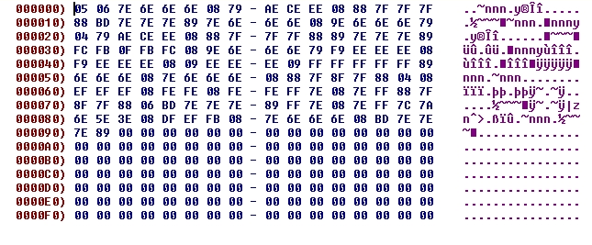
Data (Records/Columns) on Disk
Address
(offset)
not stored
Stored Data
Block 0
Data 0
Data 1
Data 2
Data 3
Block 1
Data 4
Data 5
Data 6
Data 7

Slide 6

Improving Access Time ?
What are the costs in I/O requests?
I/O cost = secondary storage access + queuing delays
disk access = seek time + rotational delay + transfer time
Block transfer, Buffering and Prefetching, Multiple/RAID disks
Queuing delays are reduced with scheduling
Elevator (Scan) Algorithm and its variations
Data access cost is reduced with data organization
Notes:
I/O cost = disk access + wait/queuing delays = seek time + rotation latency + data transfer rate + queuing
Disk access is reduced with data organization whereas queuing delays with scheduling.

Slide 7

But first, how is data stored?

Slide 8


Two Store Approaches
Row Stores
Column Stores

Slide 9
Example Table
CREATE TABLE Student (
SID INTEGER
name CHAR(16),
address CHAR(130),
gender CHAR(1),
birthdate DATE
);
DATE: 10-char string YYYY-MM-DD Fixed-length character string char(10)
example: 2002-09-15

Slide 10
Row Stores
gender
156
SID
name
address
0
4
20
152
birthdate
Store fields in one record contiguously on disk with word allignment
Use small (e.g., 4K) disk blocks
unspanned
block header record1 record2 … record3
block header record1 record2 … record3
block header record4
spanned
record4
Notes:
Record (tuple, data item, object)

Slide 11

Column Stores
SELECT SID, gender FROM Students;
gender
Birthday
Name
SID
Address

Slide 12
File Types
Unordered files
Ordered files
Clustered files
Hash files
File header or descriptor includes:
field names and their data types
address of the file block on disk
File header block1 block2 … blockN

Slide 13

Unordered Files
The simplest file structure: records are stored in no particular order
Also called: Heap, Pile, or Random File
New records are inserted at the end of file
The last disk block is copied into buffer (i.e., memory)
New record is added
Block is rewritten back to disk
Record insertion is quite efficient

Slide 14
Example of Heap File
CREATE TABLE deposit (
account_number CHAR(10),
branch_name CHAR(22),
balance REAL
)
Block 1
Block 2
Record 0 | A-102 | Oakland | 400
Record 1 | A-305 | Shadyside | 350
Record 2 | A-101 | Downtown | 700
Record 3 | A-222 | Squirrel Hill | 500
Record 4 | A-217 | Shadyside | 900
Record 5 | A-110 | Waterfront | 340
Record 6 | A-257 | Oakland | 600
Record 7
Notes:
Q: How many bytes will a record need if we must have everything aligned by multiples of 4?
A1: 10➔12, 22➔24, 8➔8, therefore we need 44 bytes total

Slide 15
Heap Files: Insert
Insert Record 7
Record 0 | A-102 | Oakland | 400
Record 1 | A-305 | Shadyside | 350
 | A-101 | Downtown | 700
Record 3 | A-222 | Squirrel Hill | 500
Record 4 | A-217 | Shadyside | 900
Record 5 | A-110 | Waterfront | 340
Record 6 | A-257 | Oakland | 600
Record 7
Record 0 | A-102 | Oakland | 400
Record 1 | A-305 | Shadyside | 350
 | A-101 | Downtown | 700
Record 3 | A-222 | Squirrel Hill | 500
Record 4 | A-217 | Shadyside | 900
Record 5 | A-110 | Waterfront | 340
Record 6 | A-257 | Oakland | 600
Record 7 | A-354 | Oakland | 420

Slide 16
Heap Files: Delete
remove Record 2
Record 0 | A-102 | Oakland | 400
Record 1 | A-305 | Shadyside | 350
Record 3 | A-222 | Squirrel Hill | 500
Record 4 | A-217 | Shadyside | 900
Record 5 | A-110 | Waterfront | 340
Record 6 | A-257 | Oakland | 600
Record 7 | A-403 | Downtown | 250
Record 0 | A-102 | Oakland | 400
Record 1 | A-305 | Shadyside | 350

Record 3 | A-222 | Squirrel Hill | 500
Record 4 | A-217 | Shadyside | 900
Record 5 | A-110 | Waterfront | 340
Record 6 | A-257 | Oakland | 600
Record 7 | A-403 | Downtown | 250
Record 2 A-101 Downtown 700

Slide 17
Heap Files: Insert & Delete (optimized)
remove Record 2
add Record 8
Record 0 | A-102 | Oakland | 400
Record 1 | A-305 | Shadyside | 350

Record 3 | A-222 | Squirrel Hill | 500
Record 4 | A-217 | Shadyside | 900
Record 5 | A-110 | Waterfront | 340
Record 6 | A-257 | Oakland | 600
Record 7 | A-403 | Downtown | 250
Record 0 | A-102 | Oakland | 400
Record 1 | A-305 | Shadyside | 350
Record 8 | A-354 | Oakland | 420
Record 3 | A-222 | Squirrel Hill | 500
Record 4 | A-217 | Shadyside | 900
Record 5 | A-110 | Waterfront | 340
Record 6 | A-257 | Oakland | 600
Record 7 | A-403 | Downtown | 250
-- Periodic reorganization: records are packed by removing deleted records

Slide 18

Properties of Unordered Files
File records are inserted at the end of the file or in any file block with free space.
Thus, insertion is efficient.
To search for a record, a linear search through the file records is necessary which is quite expensive.
Reading the records in order of any field requires sorting the file records.

Slide 19
Ordered Files
Also called sequential files.
File records are kept sorted by the value of an ordering key which has unique value (e.g., primary key)
CREATE TABLE deposit (
account_number CHAR(10),
branch_name CHAR(22),
balance REAL
)
Record 0 | A-101 | Downtown | 700
Record 1 | A-102 | Oakland | 400
Record 2 | A-205 | Shadyside | 350
Record 3 | A-217 | Shadyside | 900
Record 4 | A-222 | Squirrel Hill | 500
Record 5 | A-310 | Waterfront | 340
Record 6 | A-357 | Oakland | 600
Record 7 | A-403 | Downtown | 250
Fixed-length records
10 + 22 + 8 = 40 bytes
Notes:
Q: How many bytes will a record need if we must have everything aligned by multiples of 4?
A1: 10➔12, 22➔24, 8➔8, therefore we need 44 bytes total

Slide 20
Properties of Ordered Files
Insertion is expensive: records must be inserted in the correct order.
Deletion?
Search for a record on its ordering field value is quite efficient (binary search algorithm).
Search for a record on a non-ordering field?
Reading the records in order of the ordering field is also quite efficient.
Reading the records in any order?

Slide 21
Clustered Files
Order files with ordering field which is not a key
Ordering field has not a unique value
DEPTNUM
1
1
1
2
2
3
3
3
3
3
4
4
NAME
SSN
JOB
BIRTHDATE
SALARY
5
5
5
5
6
6
6
6
6
8
8
8
Properties?
Purpose ?

Slide 22
Clustered File: Example 2
For efficient insertion, deletion and search, each group of records with different ordering field is stored on separate block
1
1
1
Block
Pointer
2
2
Block
Pointer
3
3
3
3
Block
Pointer
3
Block
Pointer
4
4
Block
Pointer
5
5
5
5
Block
Pointer

Slide 23
Hash Files
Also called direct files
External hashing maps keys to disk blocks
Works similar to internal hashing
Static hashing
Dynamic file expansion
Linear hashing
Extendible hashing

Slide 24
Static Hashing
Hashing converts the key of a record into an address in which the record is stored.
An external hash function maps the key to the relative address of a bucket in which the record is stored.
if a file is allocated s buckets, the hash function must convert a key k into the relative address of the block:
h(k)∈{0, ..., s-1}
A bucket is either one disk block or a cluster of contiguous blocks
A table stored in the header of the file maps relative bucket numbers to disk block addresses.

Slide 25
Static Directed File
0 | 1 | 2 | 3 | … | S-1
File Header
h(k)
k
0
1
2
3
..
S-1
k % S

Slide 26
Static Directed File
0 | 1 | 2 | 3 | … | S-1
File Header
h(k)
k
0
1
2
3
..
S-1
k % S

Slide 27
Collision
Insertion of a new record may lead to collision.
No space in B = h(k)
Probing or conflict resolution:
Open Addressing (Rehashing): If bucket h(k) is full, use another hash function until a bucket with a free space is found.
E.g., linear probing
α = h(key) = key mod s
rh(α) = h (α +1)
Not a very good technique for databases (Why?)
Chaining: Use overflow buckets.

Slide 28
Static Directed File
0 | 1 | 2 | 3 | … | S-1
File Header
h(k)
k
0
1
2
3
..
S-1
k % S
Overflow Bucket Blocks
Each bucket has its own overflow blocks

Slide 29
Handling of the Overflow Area
Three approaches:
Common overflow area for all blocks in the file.
Each block has a pointer to its first record in the overflow area.
Records belonging to the same block are linked by pointers.
Overflow Area

Slide 30
Handling of the Overflow Area
Share overflow area by some blocks
e.g., residing on the same cylinder.
Individual overflow areas
Each block has its own overflow
Records are not linked

Slide 31
Hashing Functions
A good hash functions must
be computed efficiently
minimize the number of collisions by spreading keys around the file as evenly and uniform as possible.
Example of good functions
truncation
division: h(key) = key mod s
Mid-square
Folding or partitioning
Other ad hoc methods
Order preserving hash functions:
Maintain records in order of hash field values
Notes:
Order preserving: special case when keys are generated in order
Like the leftmost three digits of an invoice as hash address and sort records by invoice number within buckets.

Slide 32
Pros and Cons of Hashing
Excellent performance for searching on equality on the key used for hashing (assuming low density).
Records are not ordered (heap files).
⇒ Any search other than on equality is very expensive (linear search or involves sorting).
Prediction of total number of buckets is difficult.
allocate a large space.
estimate a ``reasonable'' size and periodically reorganize.

Slide 33
Dynamic Hashing Methods
Allow the file size to change as records are added or deleted.
Linear Hashing
No additional structure
Extendible Hashing
Binary Hashing

Slide 34
Linear Hashing
The file size grows linearly, bucket by bucket, using a family of hash functions, each has double the range of its predecessor
The file starts with s main buckets, where s is a power of 2, and k overflow buckets.
Buckets are numbered from 0 to s-1
=> initial hashing function h₀(key) = key mod s.
Collisions are handled thru chaining.
We keep the following info:
B_{last}: A pointer to the current last bucket.
Initially, B_{last} = s-1.
B_{split}: A pointer to the bucket that should be split next. Initially, B_{split} = 0

Slide 35
Insertion of a Record (Method 1)
if there is a collision, push tuple to an overflow bucket.
if there are no overflow buckets available, proceed as follows until one becomes available:
A new bucket is appended at the end of the hash table and B_{last} = B_{last} +1
Records in B_{split} bucket are hashed again using
h₁(key) = key mod (2s),
-- these will either remain in B_{split} or stored in B_{last}
this may free an overflow bucket.
B_{split} becomes B_{split} +1.
if B_{last} = 2s-1 set s = 2s, B_{last} = s-1, B_{split} =0, h₀(key)=h₁(key)
proceed as above.
Notes:
if B_{last} = 2s-1, it means that all initial buckets have been split and the hash table has double its size. At this point: set s = 2s, B_{last} = s-1, B_{split} =0

Slide 36
Insertion of a Record (Method 2)
if there is a collision, push tuple to an overflow bucket.
if there are no overflow buckets available, proceed as follows until one becomes available:
A new bucket is appended at the end of the hash table (but B_{last} does not change as in Method 1)
Records in B_{split} bucket are hashed again using
h₁(key) = key mod (2s),
-- these will either remain in B_{split} or stored in B_{last}
this may free an overflow bucket.
B_{split} becomes B_{split} +1.
if B_{last} < B_{split} set s = 2s, B_{last} = s-1, B_{split} =0, h₀(key)=h₁(key)
proceed as above.
Notes:
if B_{last} = 2s-1, it means that all initial buckets have been split and the hash table has double its size. At this point: set s = 2s, B_{last} = s-1, B_{split} =0

Slide 37
Example
0 | 1 | 2 | 3
0 | 1 | 2 | 3
4
4
1
6
3
0
1
6
3
4
0
5
7
8
5
7
8
B_{split}= 0
B_{last}=3
B_{split}= 1
B_{last}=3
h₀(k)=k mod 2²
h₀(k)=k mod 2²
h₁(k)=k mod 2³
1,
4,
3,
0,
6,
8,
5,
7,
16
16 ?
Is B_{split} > B_{last} ?

Slide 38
Example
0 | 1 | 2 | 3
4
0 | 1 | 2 | 3
4
5
0
1
6
3
4
0
1
6
3
4
5
8
5
7
12
8
9
7
12
16
9
16
B_{split}= 1
B_{last}=3
B_{split}= 2
B_{last}=3
h₀(k)=k mod 2²
h₁(k)=k mod 2³
1,
4,
3,
0,
6,
8,
5,
7,
16,
12,
9,
13
13?
Is B_{split} > B_{last} ?

Slide 39
Example
0 | 1 | 2 | 3
4
5
0 | 1 | 2 | 3
4
5
6
0
1
6
3
4
5
0
1
3
4
5
6
8
9
7
12
13
8
9
7
12
13
16
11
16
11
B_{split}= 2
B_{last}=3
B_{split}= 3
B_{last}=3
h₀(k)=k mod 2²
h₁(k)=k mod 2³
1,
4,
3,
0,
6,
8,
5,
7,
16,
12,
9,
13,
11,
15
15 ?
Is B_{split} > B_{last} ?

Slide 40
Example
0 | 1 | 2 | 3
4
5
6
0 | 1 | 2 | 3
4
5
6
7
0
1
3
4
5
6
0
1
3
4
5
6
7
8
9
7
12
13
8
9
11
12
13
16
11
16
B_{split}= 3
B_{last}=3
B_{split}= 4
>
B_{last}=3
h₀(k)=k mod 2²
h₁(k)=k mod 2³
1,
4,
3,
0,
6,
8,
5,
7,
16,
12,
9,
13,
11,
15
15 ?
Is B_{split} > B_{last} ?

Slide 41
Example
0 | 1 | 2 | 3
4
5
6
7
0
1
3
4
5
6
7
8
9
11
12
13
15
16
B_{split}= 0
B_{last}=7
h₀(k)=k mod 2²
h₀(k)=k mod 2³
h₁(k)=k mod 2³
h₁(k)=k mod 2⁴
1,
4,
3,
0,
6,
8,
5,
7,
16,
12,
9,
13,
11,
15 ?
15

Slide 42
Search for a record
Search for a Record
I = h₀(key)
if I < B_{split} then I = h₁(key)
search the bucket whose hash value is I (and its overflow, if any).

Slide 43
Variations
Split a bucket either when there is a need for an overflow bucket or based on some threshold u, e.g., u > 0.9
u is an upper bound of the file load factor or number of records that current buckets may store,
l = r/( bfr * N)
r = current number of records, N = current number of buckets
bfr= blocking factor = number of records in a bucket
Combination can be triggered when, e.g., u < 0.7

Slide 44
Variations
Split a bucket either when there is a need for an overflow bucket or based on some threshold u, e.g., u > 0.9
u is an upper bound of the file load factor or number of records that current buckets may store,
l = r/( bfr * N)
r = current number of records, N = current number of buckets/
Combination can be triggered when, e.g., u < 0.7
Use a single hashing function:
A = k mod 2s
if A > B_{last}
then A = A- s
else A

Slide 45
Example
0 | 1 | 2 | 3
4
5
6
7
0
1
3
4
5
6
7
8
9
11
12
13
15
16
B_{split}= 0
B_{last}=7
h₀(k)=k mod 2²
h₀(k)=k mod 2³
h₁(k)=k mod 2³
h₁(k)=k mod 2⁴
1,
4,
3,
0,
6,
8,
5,
7,
16,
12,
9,
13,
11,
15 ?
15

Slide 46
Dynamic Hashing Methods
Allow the file size to change as records are added or deleted.
Linear Hashing
No additional structure
Extendible Hashing
Binary Hashing

Slide 47
Extendible Hashing
The file is structured into two levels: directory and buckets.
0
1
d
1
Bucket Directory
2 / 0010
4 / 0100
3 / 0011
5 / 0101
9 / 1001
Buckets, not stored continuously
d’
1
1

Slide 48
Extendible Hashing
Directory contains only pointers to buckets (no keys)
Use some hash function to generate a pseudokey of b-bits (typically b=32)
Use the first (or last) d bits to find the offset of the bucket pointer in the directory.
d is called the (global) directory depth. It may be stored in the directory
In each bucket a local depth d' is stored indicating the most (or least) significant bits common to all keys in that bucket (d'≤ d)

Slide 49
Extendible Hashing – File Growth
No overflow buckets. New buckets are added one by one.
When a bucket B with local depth d' overflows, B is split into two buckets and all keys are rehash using d'+1 bits
If after a split, d' > d, double the size of the directory (d=d+1) to accommodate the growth

Slide 50
Example
Use the least significant bits as bucket keys
Each bucket can hold three records
The keys to insert are 1,4,3,0,6,8,5,7,16,12,9,13

Slide 51
Example
d
1
0
1
4/0100
1/0001
0/0000
3/0011
6/0110
d’
1
1
1,
4,
3,
0,
6,
8/1000

Slide 52
Example
d
2
00
10
01
11
4/0100
1/0001
0/0000
3/0011
6/0110
d’
1
1
1,
4,
3,
0,
6,
8/1000

Slide 53
Example
d
2
00
01
01
11
4/0100
6/0110
1/0001
0/0000
3/0011
8/1000
5/0101
d’
2
2
1
1,
4,
3,
0,
6,
8,
5,
7

Slide 54
Example
d
2
00
10
01
11
4/0100
6/0110
1/0001
0/0000
3/0011
8/1000
5/0101
d’
2
2
1
1,
4,
3,
0,
6,
8,
5,
7/0111

Slide 55
Example
d
2
00
10
01
11
4/0100
6/0110
1/0001
3/0011
0/0000
5/0101
7/0111
8/1000
d’
2
2
2
2
1,
4,
3,
0,
6,
8,
5,
7,
16/10000

Slide 56
Example
d
3
000
100
010
110
001
101
011
111
4/0100
6/0110
1/0001
3/0011
0/0000
5/0101
7/0111
8/1000
d’
2
2
2
2
1,
4,
3,
0,
6,
8,
5,
7,
16/10000

Slide 57
Example
d
3
000
100
010
110
001
101
011
111
0/0000
4/0100
6/0110
1/0001
3/0011
8/1000
12/1100
5/0101
7/0111
16/1000
9/1001
d’
3
3
2
2
2
1,
4,
3,
0,
6,
8,
5,
7,
16,
12,
9,
13/1101

Slide 58
Example
d
3
000
100
010
110
001
101
011
111
0/0000
4/0100
6/0110
1/0001
5/0101
3/0011
8/1000
12/1100
9/1001
13/1101
7/0111
16/1000
d’
3
3
2
3
3
2
1,
4,
3,
0,
6,
8,
5,
7,
16,
12,
9,
13

Slide 59
Example
d
2
00
01
10
11
4/0100
1/0001
0/0000
3/0011
6/0110
d’
1
1
1,
4,
3,
0,
6,
8

Slide 60
Example
d
2
00
01
10
11
4/0100
6/0110
1/0001
3/0011
0/0000
5/0101
7/0111
8/1000
d’
2
2
2
2
1,
4,
3,
0,
6,
8,
5,
7,
16

Slide 61
Example
d
3
000
001
010
011
100
101
110
111
4/0100
6/0110
1/0001
3/0011
0/0000
5/0101
7/0111
8/1000
d’
2
2
2
2
1,
4,
3,
0,
6,
8,
5,
7,
16

Slide 62
Extendible Hashing
The file is structured into two levels: directory and buckets.
0
1
d
1
2 / 0010
4 / 0100
3 / 0011
5 / 0101
9 / 1001
d’
1
1

Slide 63
Extendible Hashing
Directory contains only pointers to buckets (no keys).
Use some hash function to generate a pseudokey of b-bits (typically b=32)
Use the first (or last) d bits to find the offset of the bucket pointer in the directory.
d is called the (global) directory depth. It may be stored in the directory.
In each bucket a local depth d' is stored indicating the most (or least) significant bits common to all keys in that bucket (d'≤ d).

Slide 64
Extendible Hashing – File Growth
No overflow buckets. New buckets are added one by one.
When a bucket B with local depth d' overflows,
B is split into two buckets and all keys are rehash using d'+1 bits.
If after a split, d' > d, double the size of the directory (d=d+1) to accommodate the growth.

Slide 65
Last Lecture of 20-1

Slide 66
Improving Access Time
Data access time could be improved by:
Scheduling
Block transfer
Buffering and Prefetching
Cylinder-based Organization
Multiple disks
Record Placement

Slide 67
Improving Access Time
Data access time could be improved by:
Scheduling
Block transfer
Buffering and Prefetching
Cylinder-based Organization
Multiple disks
Record Placement

Slide 68

Queuing Delay

Slide 69
Queuing Delay
Queuing Delay occurs when:
multiple queries are executed at the same time, and
those queries access the same disk at the same time (i.e., send I/O requests)
The disk head can only serve one request at a time!
Solution:
Smart scheduling of serving disk requests
Parallel processing (multiple disks organizations)

Slide 70
Elevator Algorithm Example
First-Come First-Served
Using Elevator Algorithm
cylinder request | arrival time
1000 | 0
3000 | 0
7000 | 0
2000 | 20
8000 | 30
5000 | 40
cylinder request | competion time | wait time
1000 | 8.3 ms | 8.3
3000 | 21.6 ms | 21.6
7000 | 38.9 ms | 38.9
2000 | 58.2 ms* | 38.2
8000 | 79.5 ms | 49.5
5000 | 94.8 ms | 54.8
cylinder request | competion time | wait time
1000 | 8.3 ms | 8.3
3000 | 21.6 ms | 21.6
7000 | 38.9 ms | 38.9
8000 | 50.2 ms | 20.2
5000 | 65.6 ms | 25.5
2000 | 80.8 ms | 60.8
58.2 ms = 38.9 + [1+ (7000-2000)/500] + 7.8 + 0.5 ms
Block transfer time
last completion time
seek time
rotational latency
Notes:
Assumes it is on cylinder 1000 so data access = rotational latency + block transfer time = 7.8+0.5 =8.3 ms

Slide 71
Disk scheduling: Elevator Algorithm
Idea : Schedule reading of requested blocks in the order in which they appear under the head
Elevator Algorithm (Scan) - Works like an elevator
The arm moves towards one direction serving all requests on the visited tracks
Reverses direction when no more pending requests
Advantage:
Reduces average access time for unpredictable requests
Problem:
It is more effective in many disk-access requests
The benefit is not uniform among requests
Notes:
The benefit is not uniform among requests – requests that have just miss the elevator – middle tracks are visited twice as much of the other ones, especially the edges.
But without the good scheduling algorithm, throughput would decrease and the disk would not satisfy the requests at the generated rate, long delays.

Slide 72
Variations of Elevator Algorithm
Scan or Elevator Algorithm
services both directions and reverses direction when reaches the edge of the disk
C-Scan or Circular Elevator Algorithm
all requests are serviced in only one direction
more equal performance for all head positions
Look
Scan but changes direction when no more pending requests
C-Look
Combination of Look and C-Scan
FCScan
prevents "arm stickiness" by using two queues (Q1 & Q2)
When Scan uses Q1 with old requests, new requests go to Q2

Slide 73
Improving Access Time
Data access time could be improved by:
Scheduling
Block transfer
Buffering and Prefetching
Cylinder-based Organization
Multiple disks
Record Placement

Slide 74

Block Transfer
To minimize access time: data is always transferred from/to disks by blocks of bytes
A disk block is an adjacent sequence of sectors from a single track of one platter
Block size typically ranges from 512 bytes to 4KBytes.

Slide 75
Improving Access Time
Data access time could be improved by:
Scheduling
Block transfer
Buffering and Prefetching
Cylinder-based Organization
Multiple disks
Record Placement

Slide 76

Buffering / Caching
Idea: Keep as many blocks in main memory as possible to maximize the likelihood that a block of data needed by a transaction is in main memory
Might run out of memory space ➔ replace blocks!
Replacement Policies:
LRU (Least Recently Used)
MRU (Most Recently Used)
LFU (Least Frequently Used)
Dual-greedy (e.g., LRU & LFU)
…
Notes:
Borrower Join Customer
Keep index rather than the data blocks.
15 March 2011: copied the next 3 slides from recovery techniques. Integrate here and delete from recovery.

Slide 77

Prefetching or Double Buffering
Situation: Needed data are known, but the timing of the request is data-dependent
Idea: speed-up access by pre-loading needed data
Cons:
requires extra main memory
no help if requests are random (unpredictable)
Notes:
Borrower Join Customer
Keep index rather than the data blocks.
15 March 2011: copied the next 3 slides from recovery techniques. Integrate here and delete from recovery.

Slide 78
Improving Access Time
Data access time could be improved by:
Scheduling
Block transfer
Buffering and Prefetching
Cylinder-based Organization
Multiple disks
Record Placement

Slide 79
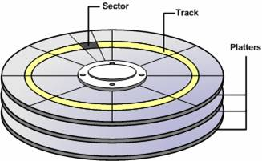
Cylinder-based Organization
Observation: Data such as in relations is likely to be accessed together
Idea: Store such data on the same cylinder
Blocks are “Next” to each other
Blocks on a track or on a cylinder effectively involve only the first seek time and first rotational latency
Advantage:
Approaches the theoretical transfer rate
Excellent if access can be predicted in advance
Only one process/transaction is using the disk

Slide 80

Multiple Disks
Observation:
Disk drives continue to become smaller and cheaper
Idea:
Use multiple disks to support parallel access
Disks with independent heads connected to a single disk controller
2X20 GB drives is faster than a single 40GB drive
Bur more expensive…
More efficient if they are kept busy!
It also enhances system reliability thru redundancy!!

Slide 81
Improving Access Time
Data access time could be improved by:
Scheduling
Block transfer
Buffering and Prefetching
Cylinder-based Organization
Multiple disks
Record Placement

Slide 82
Multiple Disks: Organizations
Data partitioning over several disks
Pros: increased access rate
Problem: if popular data is stored on same disk ➔ request collisions (hot spots)
Cons: the cost of several small disks is greater than a single one with the same capacity
Mirror disks: Disks hold identical copies
Pros: Doubles read rate (disk 1 OR 2)
Does not have the problem of request collisions
Does not slow down write requests (disk 1 AND 2)
Cons: Pay cost for two disks to get the storage of one
Notes:
Several disks with independent heads connected to a single disk controller.
Mirror disks do not speed-up writing but do not slow writing down; minor difference in writing times.
In Two mirror disks the rate of read requests is double.

Slide 83

RAID Technology

Slide 84
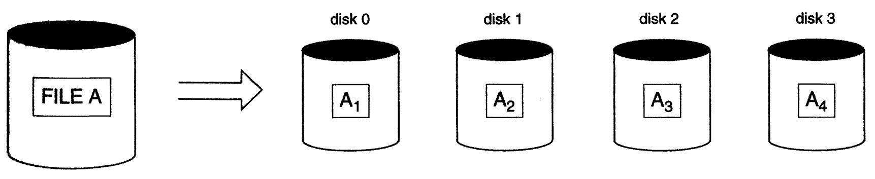
RAID Technology
A major advance in secondary storage technology is represented by the development of RAID
Redundant Arrays of Inexpensive (independent) Disks
Acts as a single high-performance large disk
Data Striping: distributes data transparently over multiple disks to make them appear as a single large, fast disk

Slide 85

Data Striping
Bit-level striping: Split groups of bits over different disks
Example: split each bit of a bytes over 8 disks
Bit number x is written on disk number x
Every disk participates in every access
every access reads 8 times as many data
Block-level striping for blocks of a file
Sector-level striping for sectors of a block
RAID Goals:
Parallelize accesses so the access time is reduced
Combining Striping, Mirroring and Reliability ➔ levels of RAID
Notes:
Data striping distributes data transparently over multiple disks to make them appear as a single disk.
Bit level striping can generalized to number of disks that is either multiple of 8 or divides of 8. E.g., for 4 disks, n bit goes to disk (n mod 4).
Increase throughput = decrease I/O queuing delays

Slide 86
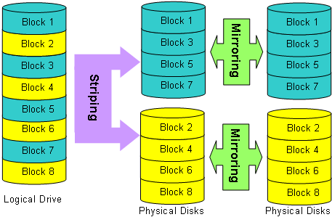
Raid 0

Slide 87
Raid 0-1

Slide 88
Levels of RAID
0: Non-Redundant
1: Mirrored
2: Memory Style ECC
3: Bit-Interleaved Parity
4: Block Interleaved Parity
5: Block-Interleaved Distribution-Parity
6: P+Q Redundancy
Notes:
0-4 were proposed initially and 5-6 added latter.
0: worst reliability; best write performance since updates are not dublicated
1:reliability, better read performance
2: Uses Hamming codes, which contain parity bits for distinct overlapping subsets of components. As a result only 3 disks are required.
3. Uses a single parity bit, relying on the controller to detect failed disks
4-5 block striping
6: Uses the P+Q scheme of Reed-Soloman codes that protects against up to two disk failures using 2 redundant disks.
Modulo-2 sum is 0 if even number of bits, 1 if there is an odd number.
Small reads and writes: I/O requests for 1 stripping unit
Large reads and writes: I/0 requests for 1 stripe unit from each disk

Slide 89
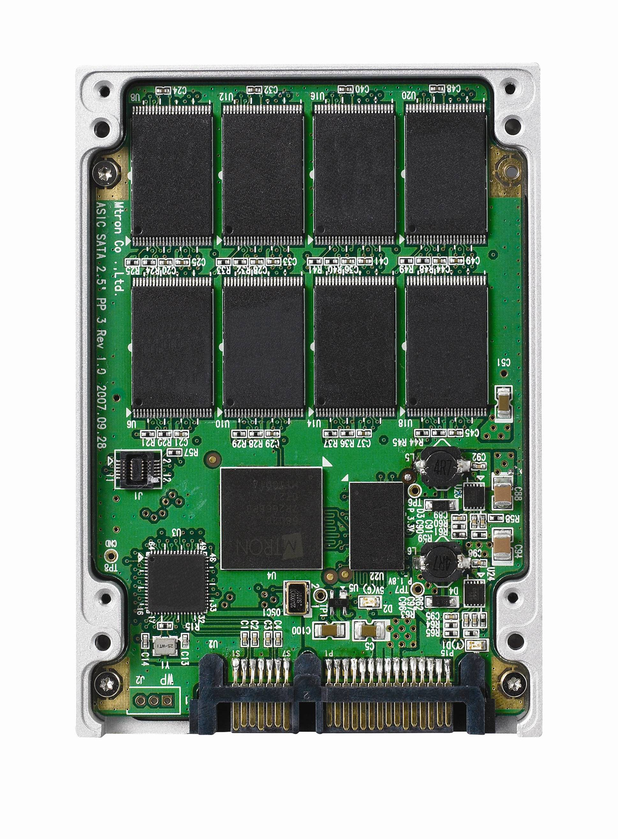
Solid State Disk
Idea: A SSD is essentially an array of NAND-flash memory devices which include a controller that emulates a hard disk drive
flash translation layer (FTL)
single-level cell (SLC) flash
Organization (flash):
One or more dies (chips), each 8192 blocks
Dies are organized in planes (e.g., 4 planes of 2018 blocks)
Blocks is a set of pages 128—256KB (i.e., 32—64 pages)
Page is the unit of read and write (program), 512B—4KB
128 bytes are used for metadata
Page or Block is the unit of storage system write

Slide 90
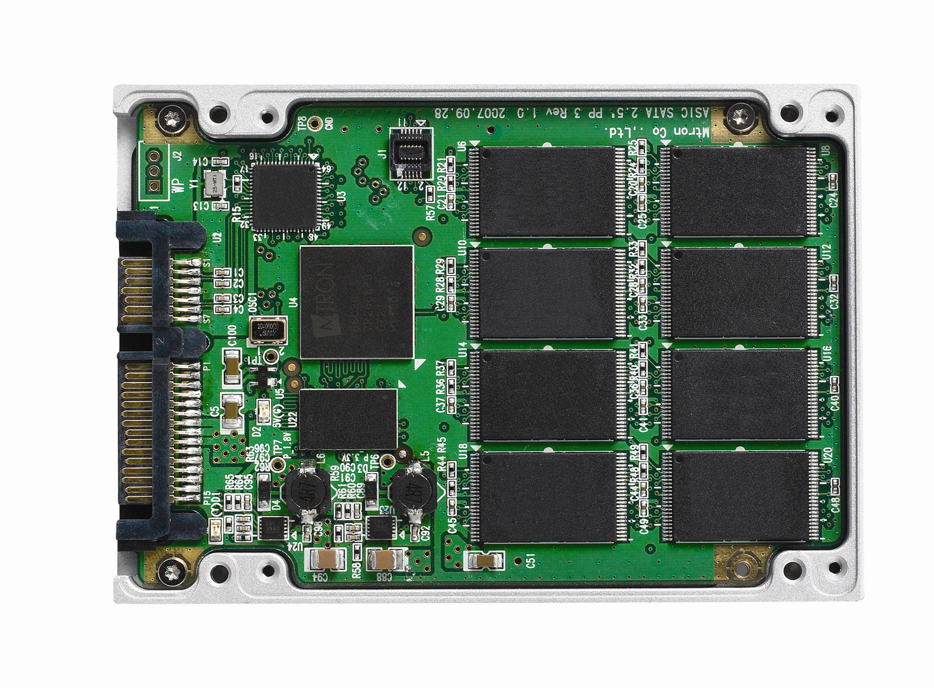
Constraints of Solid State Disks
Constraints:
Erase-Constraint (or erase-before-write): A page cannot be over-written unless the block that contains the page has been erased
Write-Constraint: Pages must be written out sequentially within a block, from low to high addresses.
if p_{i} is written, p_{i-1} cannot be written until the block is erased
Wear-Constraint: The number of times a block can be erased is limited – typically 10,000 to 100,000 times.
Cleaning and wear-leveling schemes are important
Asymmetry between operations: Write is more expensive than read (~3 times).
Notes:
Copy all neighbors

Slide 91
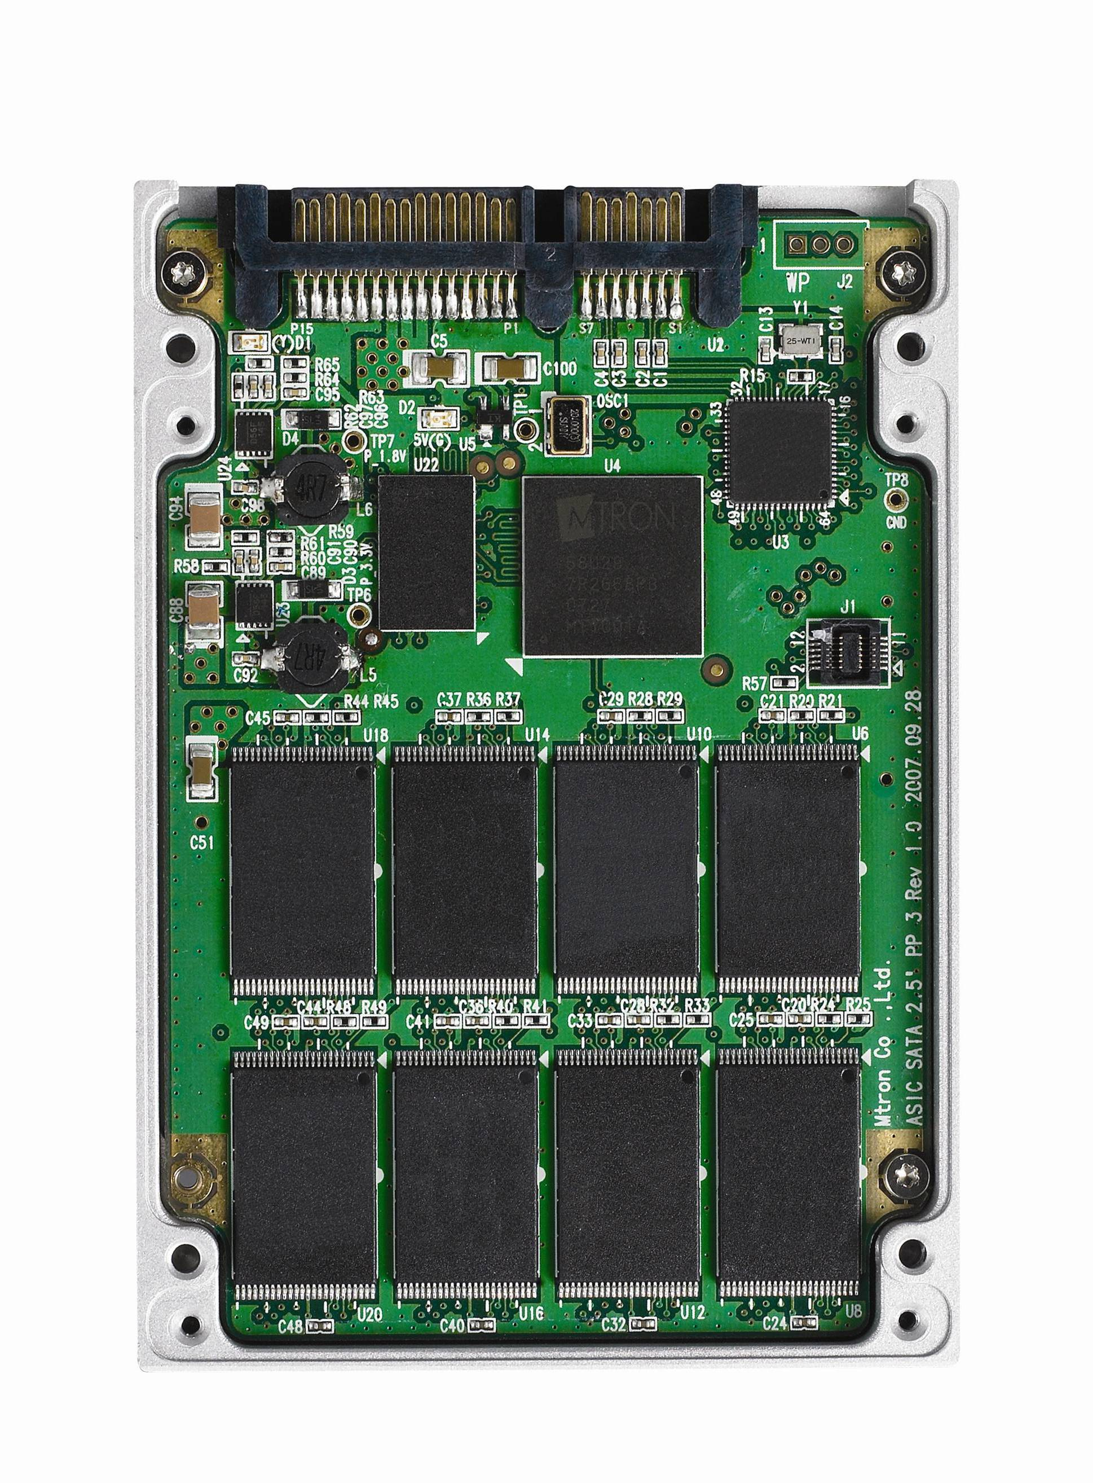
Properties of Solid State Disks
Properties:
Random and Sequential Read Access with equal cost
Faster than HDD
parallel requests, interleaving, striping.. 100K – 300K I/Os
Energy Efficient.. ~25/750μJ Read/Write, ~220μJ/s Idle
Resilient & reliable
Shock resistant and extreme temperature fluctuations
immune to strong magnetic fields
With good wear-leveling can last 10 years
Small factor and silent (unless fan is used)
Problem: Higher cost per megabyte of storage
Capacity doubles every year
Notes:
Standard HDD 5K I/Os
RAM-based SSD 600K I/Os
100K – 300K I/Os vs 100K (Enhanced RAID) vs 20 (RAID)
Values from our DMSN 2009.

Slide 92
Improving Access Time
Data access time could be improved by:
Scheduling
Block transfer
Buffering and Prefetching
Cylinder-based Organization
Multiple disks
Record Placement

Slide 93
Linear Hashing
The file size grows linearly, bucket by bucket.
The file starts with s main buckets, where s is a power of 2, and k overflow buckets.
Buckets are numbered from 0 to s-1
=> initial hashing function h₀(key) = key mod s.
Collisions are handled thru chaining.
We keep the following info:
B_{last}: A pointer to the current last bucket.
Initially, B_{last} = s-1.
B_{split}: A pointer to the bucket that should be split next. Initially, B_{split} = 0

Slide 94
Insertion of a Record (Method 1)
if there is a collision, push tuple to an overflow bucket.
if there are no overflow buckets available, proceed as follows until one becomes available:
A new bucket is appended at the end of the hash table and B_{last} = B_{last} +1
Records in B_{split} bucket are hashed again using
h₁(key) = key mod (2s),
-- these will either remain in B_{split} or stored in B_{last}
this may free an overflow bucket.
B_{split} becomes B_{split} +1.
if B_{last} = 2s-1 set s = 2s, B_{last} = s-1, B_{split} =0, h₀(key)=h₁(key)
proceed as above.
Notes:
if B_{last} = 2s-1, it means that all initial buckets have been split and the hash table has double its size. At this point: set s = 2s, B_{last} = s-1, B_{split} =0

Slide 95
Insertion of a Record (Method 2)
if there is a collision, push tuple to an overflow bucket.
if there are no overflow buckets available, proceed as follows until one becomes available:
A new bucket is appended at the end of the hash table (but B_{last} does not change as in Method 1)
Records in B_{split} bucket are hashed again using
h₁(key) = key mod (2s),
-- these will either remain in B_{split} or stored in B_{last}
this may free an overflow bucket.
B_{split} becomes B_{split} +1.
if B_{last} < B_{split} set s = 2s, B_{last} = s-1, B_{split} =0, h₀(key)=h₁(key)
proceed as above.
Notes:
if B_{last} = 2s-1, it means that all initial buckets have been split and the hash table has double its size. At this point: set s = 2s, B_{last} = s-1, B_{split} =0

Slide 96
Search for a record
Search for a Record
I = h₀(key)
if I < B_{split} then I = h₁(key)
search the bucket whose hash value is I (and its overflow, if any).

Slide 97
Variations
Split a bucket either when there is a need for an overflow bucket or based on some threshold u, e.g., u > 0.9
u is an upper bound of the file load factor or number of records that current buckets may store,
l = r/( bfr * N)
r = current number of records, N = current number of buckets/
Combination can be triggered when, e.g., u < 0.7
Use a single hashing function:
A = k mod 2s
if A > B_{last}
then A = A- s
else A

Slide 98
Extendible Hashing
The file is structured into two levels: directory and buckets.
0
1
d
1
2 / 0010
4 / 0100
3 / 0011
5 / 0101
9 / 1001
d’
1
1

Slide 99
Extendible Hashing
Directory contains only pointers to buckets (no keys).
Use some hash function to generate a pseudokey of b-bits (typically b=32)
Use the first (or last) d bits to find the offset of the bucket pointer in the directory.
d is called the (global) directory depth. It may be stored in the directory.
In each bucket a local depth d' is stored indicating the most (or least) significant bits common to all keys in that bucket (d'≤ d).

Slide 100
Extendible Hashing – File Growth
No overflow buckets. New buckets are added one by one.
When a bucket B with local depth d' overflows,
B is split into two buckets and all keys are rehash using d'+1 bits.
If after a split, d' > d, double the size of the directory (d=d+1) to accommodate the growth.

Slide 101
Row Stores: Slotted-Page Implementation
Slotted-page structure is industry standard
records can move within the page
records are allocated contiguously, starting at the beginning of the block (or starting at the end of the block)
End of block: has pointers to records (or start of block: has pointers to records)
external pointers point only to the header

Slide 102
Slotted Pages Example
R
PAGE HEADER
RH1
1237
Jane
30
RH2
4322
John
RID | SSN | Name | Age
1 | 1237 | Jane | 30
2 | 4322 | John | 45
3 | 1563 | Jim | 20
4 | 7658 | Susan | 52
5 | 2534 | Leon | 43
6 | 8791 | Dan | 37
45
RH3
1563
Jim
20
RH4
7658
Susan
52
•
•
•
•
Records are stored sequentially
Offsets to start of each record at end of page

Slide 103
Partition Attributes Across (PAX)
S-P PAGE
PAX PAGE
PAGE HEADER
RH1
1237
PAGE HEADER
1237
4322
Jane
30
RH2
4322
John
1563
7658
45
RH3
1563
Jim
20
RH4
7658
Susan
52
Jane
John
Jim
Susan
•
•
•
•
30
52
45
20
•
•
•
•
Partition data within the page for spatial locality

Slide 104
Block Transferring
Idea: To minimize effective transfer time, data are always transfer from/to disks by blocks of bytes.
A disk block is a continues sequence of sectors from a single track of one platter.
Block sizes typically range from 512 bytes to 4K.
Disk operations:
DiskRead(x,a,n)
starting from block x transfer n blocks in main memory at address a.
DiskWrite(x,a,n)
starting from main memory address a transfer n blocks to disk starting at block x
Physical address of x: <volume#, platter#, track#, sector#>
Block address of x: <volume#, sector/block#>
Notes:
Block size is defined by hardware or software

Slide 105
Buffer Manager
The goal of Cache or Buffer Manager (BM) is to maximize the likelihood that a block of data needed by a transaction is in main memory
The main memory is partitioned into buffer blocks or buffer pages (or simply buffers, blocks or pages)
The size of a page is equal to the disk block size
page0
page1
page2
page3
page4
X2 X5 X3
Buffer
pages
main memory
disk
block
disk
X0
X1
X2
X3
X4
X5
Notes:
Move this slides to storage

Slide 106
Buffer Management Table
Buffer Management Operations
Read, Write, Fetch, Flush, Force-Write
Fix, Unfix, Touch
Block
Id
dirty
bit
fix
count
Page
number
x
0
0
0
y
1
2
1
z
0
1
2

Slide 107
Multiple Disks: Organizations
Data are partition over several disks.
Pros: increase rate for predictable and random disk accesses
Problem: Disk request collisions; hence speed-up is not linear with the number of disks
Cons: the cost of several small disks is greater than a single one with the same capacity
Mirror disks: Disks hold identical copies
Pros: Doubles read rate for both predictable and random accesses and does not have the problem of request collisions
Do not slow down write requests
Cons: Pay cost for two disks to get the storage of only one.
Notes:
Several disks with independent heads connected to a single disk controller.
Mirror disks do not speed-up writing but do not slow writing down; minor difference in writing times.
In Two mirror disks the rate of read requests is double.

